Slide 1
Experimental Design - from a HTS perspective
Arvind YM Sundaram
arvind.sundaram@medisin.uio.no
Norwegian Sequencing Centre
Oslo University Hospital
Notes:
http://www.yourgenome.org/facts/types-of-genome-sequencing

Slide 2
What do we know?
Platform choice
Technology variation
Technical bias
Lane bias
Index/barcode bias
Batch effect
Duplicates
Biological question
Sample variation
Sequencing depth
Data analysis
Species-specific information
Is there a genome sequence available??
Genome size (c-value) (http://genomesize.com/)
Notes:
What is the budget?
http://www.genengnews.com/gen-articles/6-things-to-consider-before-your-next-gen-sequencing-project/4386/

Slide 3
Platform choice
Short or long fragments
~500 bp
Illumina
Short or long reads
Single or paired end
>10 kb
PacBio
Illumina
(mate pair)
Error rates
Sequencing depth
Sequencing coverage

Slide 4
Platform choice - Multiplexing
Barcodes are 6-8 bp sequences
Single index: up to 48 samples can be multiplexed
Dual index: up to 394 samples can be multiplexed
Fragment of interest
Ligated with Illumina adapters
Ligated with Illumina adapters
containing single index
Ligated with Illumina adapters
containing dual index

Slide 5
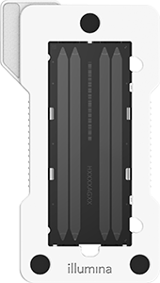



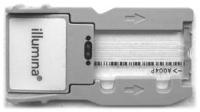
Platform choice
Options from Illumina
Pacbio > 10 kb*
HiSeq X/4000 | HiSeq 2500 |  | NextSeq 500 |  | MiSeq
6 Billion/400M | High: 4 Billion/250M | Rapid: 600M/300M | High: 400M | Mid: 130M | v3: 25M | v2: 15M
150 PE Genomic DNA only* | 36 SE 50 PE 100 PE 125 PE |  | 75 SE 75 PE 150 PE |  | 36 SE 25 PE 150 PE 300 PE

Slide 6
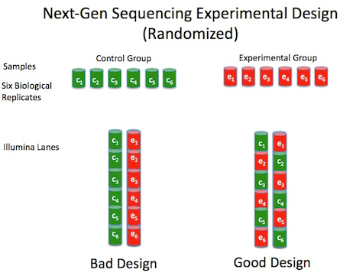
Illumina: Technical bias
Lane/flowcell bias
Index/barcode bias
Batch effect
Randomisation is key
http://nextgenseek.com/2012/10/tips-for-next-gen-sequencing-experiment-design-randomization/
Notes:
http://nextgenseek.com/2012/10/tips-for-next-gen-sequencing-experiment-design-randomization/

Slide 7
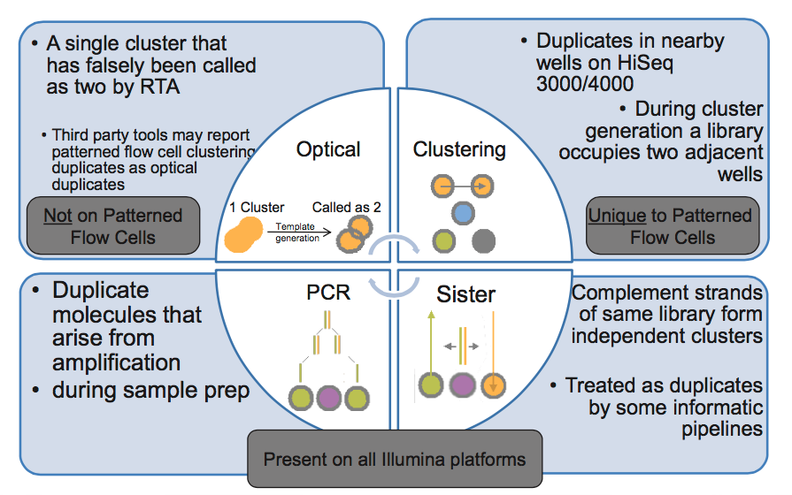
Illumina: Duplicates
Exclusion
Amplification
Optical
HiSeq X
HiSeq 4000
HiSeq 3000
http://core-genomics.blogspot.no/2016/05/increased-read-duplication-on-patterned.html

Slide 8
Biological question
Genome assembly
Not a straight forward pipeline
Evolutionary Applications 7:9, 1026-1042 (2014) doi: 10.1111/eva.12178

Slide 9
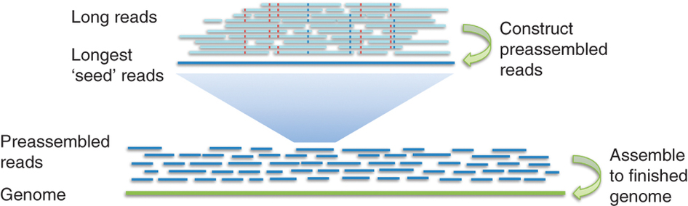
Biological question
Genome assembly
Size?
De novo?
Re-sequencing?
PacBio
Hybrid approach
Illumina
Illumina
PacBio
Evolutionary Applications 7:9, 1026-1042 (2014) doi: 10.1111/eva.12178
Nature Methods 10, 563–569 (2013) doi:10.1038/nmeth.2474

Slide 10
Biological question
Targeted sequencing
DNA protein interaction
Sequence variation
Methylation
Rearrangements and Markers
Structure
Genome available
Get away with short reads
Illumina (TSCA)
NuGen (SPET)
Agilent (HALO)
Qiagen
Wafergen
Raindance
Agilent (Sureselect )
Roche Nimblegen
(EZ exome / CpGiant)
Swift Biosciences
BioO Scientific
Directed Genomics
pxlence
http://www.illumina.com/content/dam/illumina-marketing/documents/applications/ngs-library-prep/ForAllYouSeqMethods_v19.pdf

Slide 11
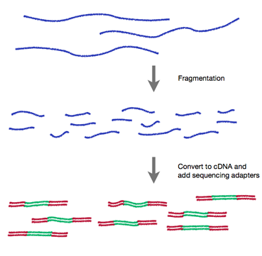

Biological question
RNA sequencing
cDNA synthesis
Strand-specific sequencing
Input RNA
Fragmented
RNA
DNA library
http://rnaseq.uoregon.edu/
Notes:
http://www.biomedcentral.com/1471-2164/13/734

Slide 12
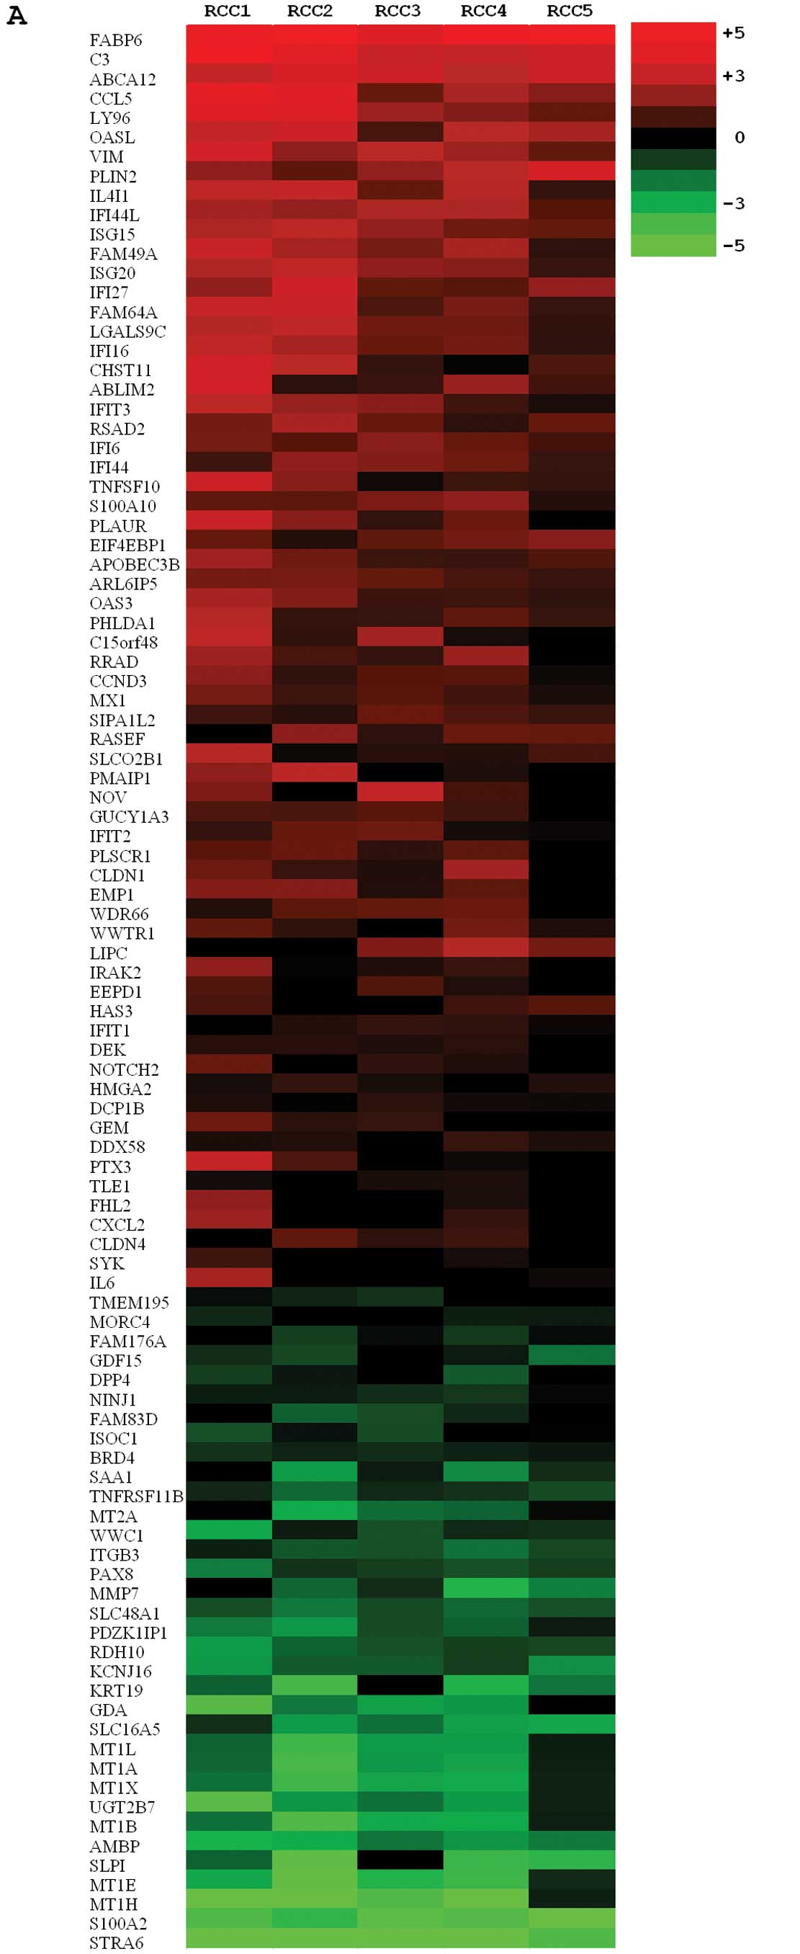
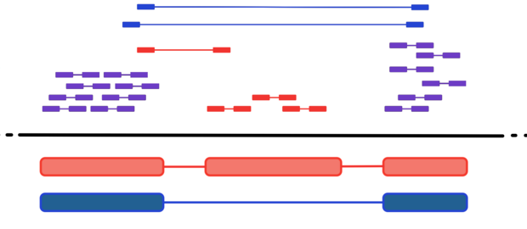
Biological question
RNA sequencing
Highly expressed known transcripts
Novel isoforms
Low expressed/rare transcripts
Aligned
Fragments
Genome
Isoform A
Isoform B
Int J Oncol. 2012 Sep;41(3):805-17. doi: 10.3892/ijo.2012.1543
http://cgrlucb.wikispaces.com/Isoform+Deconvolution+and+Unannotated+Species

Slide 13
Sequencing depth and coverage
HiSeq X
HiSeq 4000
Nature Reviews Genetics 15, 121–132 (2014) doi:10.1038/nrg3642
Notes:
Depth: The average number of times that a particular nucleotide is represented in a collection of random raw sequences.
Coverage: The average number of reads that align to, or "cover," known reference bases in the genome.

Slide 14
Sequencing depth and coverage
Sequencing depths for different applications
(Data from ENA/Illumina platform/2012-June 2013
Nature Reviews Genetics 15, 121–132 (2014) doi:10.1038/nrg3642
Notes:
Depth: The average number of times that a particular nucleotide is represented in a collection of random raw sequences.
Coverage: The average number of reads that align to, or "cover," known reference bases in the genome.

Slide 15
Sequencing depth and coverage
Staged sequencing for predicting sequencing requirements
Nature Reviews Genetics 15, 121–132 (2014) doi:10.1038/nrg3642
Notes:
Depth: The average number of times that a particular nucleotide is represented in a collection of random raw sequences.
Coverage: The average number of reads that align to, or "cover," known reference bases in the genome.

Slide 16
Sequencing depth and coverage
Representative read counts for location-based approaches
Nature Reviews Genetics 15, 121–132 (2014) doi:10.1038/nrg3642
Notes:
Depth: The average number of times that a particular nucleotide is represented in a collection of random raw sequences.
Coverage: The average number of reads that align to, or "cover," known reference bases in the genome.

Slide 17
Replicates
Nature Methods 11, 879–880 (2014) doi:10.1038/nmeth.3091
Notes:
What is the budget?
http://www.genengnews.com/gen-articles/6-things-to-consider-before-your-next-gen-sequencing-project/4386/

Slide 18
RNA-seq differential expression studies: more sequence, or more replication?
Bioinformatics (2013) doi: 10.1093/bioinformatics/btt688

Slide 19
RNA-seq differential expression studies: more sequence, or more replication?
Cost efficiency for power to detect DE genes
Bioinformatics (2013) doi: 10.1093/bioinformatics/btt688

Slide 20
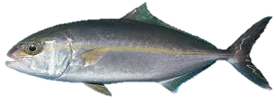
Question
Genome sequencing of Seriola dumerili (Greater Amberjack).
We need at least 100x coverage.
What is the approx. genome size of Seriola dumerili?
What type sequencing method should we use?
Plan is to use HiSeq 3000/4000 for this project.
How many lanes do we need for sequencing?

Slide 21
Finally….
Contact NSC (post@sequencing.uio.no) for sequencing advice

